Slide 1

Notes:
https://swiy.co/musopen

Slide 2

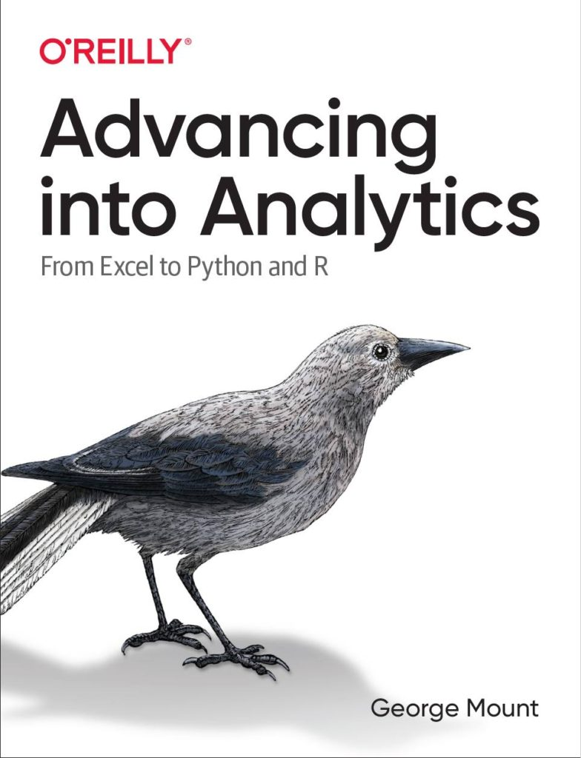


HI, I’M GEORGE
Analytics in Modern Excel

Slide 3

HI, I’M GEORGE
Analytics in Modern Excel

Slide 4
FOLLOWING ALONG
Download resources:
https://swiy.co/damx
Analytics in Modern Excel
Notes:
https://swiy.co/amx

Slide 5
FOLLOWING ALONG
Each section is a sub-folder
Demos = follow along with me
Drills = try it yourself
Refresh your memory with the demo notes
Analytics in Modern Excel
Notes:
This is an Excel class, so we won’t be looking at PowerPoint the whole time – to follow along, you will see that all assets are divided by section.
Some of our Excel time will be Demos – for this I will be walking through some procedure in Excel.
If you need any datasets they will be included in each sub-folder.
Then there may be a Drill where you will work on it for yourself during some specified period of time.
I have provided written notes/instructions about the Demos which you can refer to while working on the Drills.

Slide 6
DAY 1 OBJECTIVES
Power Query data profiling
PivotChart visualizing
Dynamic arrays for ad-hoc analysis
Foundations of exploratory data analysis
Automating Excel analysis & reporting with Python
Analytics in Modern Excel
Notes:
https://swiy.co/amx

Slide 7
DAY 2 OBJECTIVES
Automating Excel analysis & reporting with Python continued
Foundations of data science in Excel
Predictive analytics & the future of Excel
Analytics in Modern Excel
Notes:
https://swiy.co/amx

Slide 8
TERMS OF ENGAGEMENT
Feel free to share the download link with latecomers ☺
Participation is welcome via the chat (or please ask to be unmuted!)
Demos work best with 365 on Windows, I cannot guarantee other systems
Recording goes out later today and is up for one week
Analytics in Modern Excel

Slide 9

QUESTIONS?

Slide 10
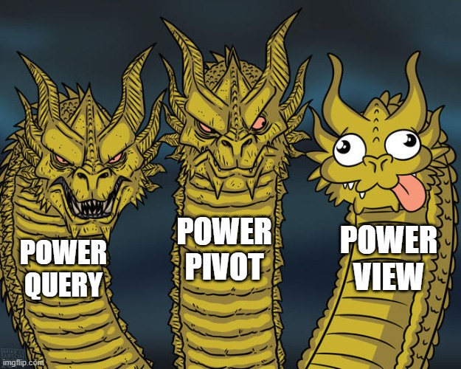
WHAT IS MODERN EXCEL?
Historically:
Power Query
Power Pivot
Power View
We’ll substitute
Dynamic arrays
Python integrations
Classic Excel
Analysis ToolPak
PivotTables & Charts
Notes:
What comes to mind when you think of

Slide 11
Data profiling with Power Query

Slide 12
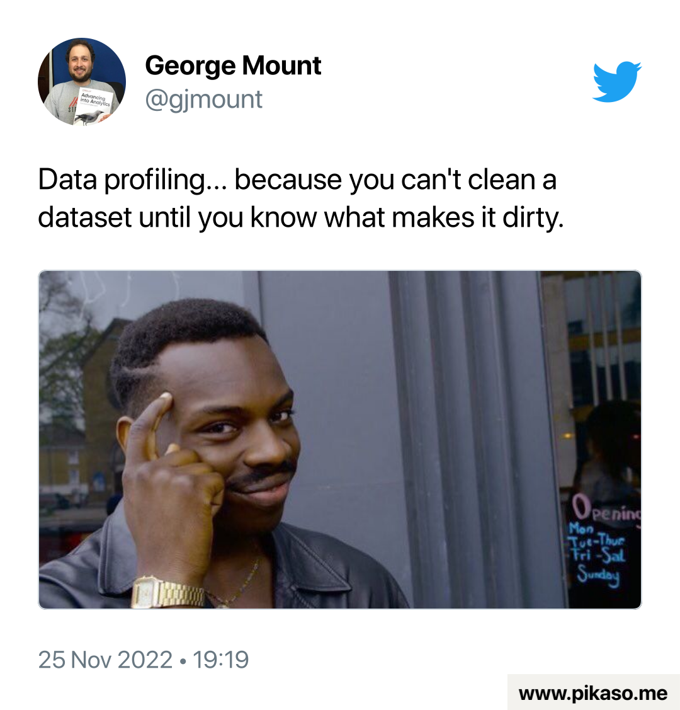
Data profiling: a 30K-foot view of the data
Does the dataset include everything?
How accurate is the data?
If the data is kept in Excel, are there any formula errors that could harm future analyses?
Is it clear what variable & observations are being measured?
Notes:
Now we are used to structured data but unstructured data is coming into vogue and there are ways to use them together…

Slide 13
Data prep & profiling with Power Query
File: computers.xlsx
Profiling the data for potential issues
Adding an index column for slicing and dicing
Notes:
Now you are hyped up Power Query, I think you are going to love it and it will be hard for you to remember the days when you didn’t have it. So let’s think about what we would do without Power Query.

Slide 14
PivotChart/Table visualization tricks

Slide 15
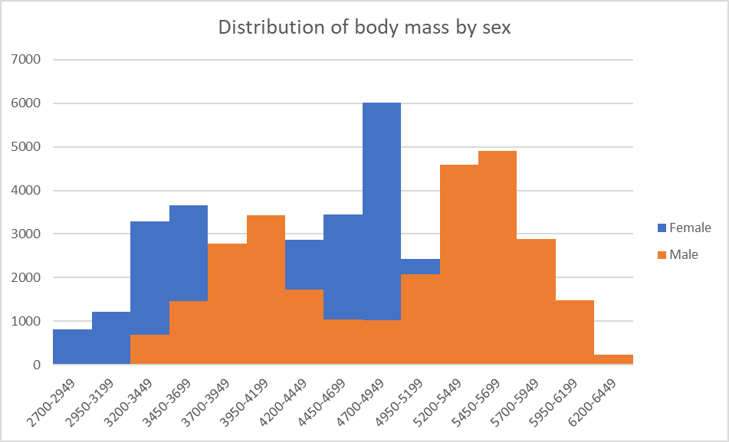
From data profiling to data visualization
The data profiler is helpful but not too dynamic
Power Query allows loading directly to PivotCharts
How can we “hack” them to visualize multiple distributions at once?
Notes:
Now we are used to structured data but unstructured data is coming into vogue and there are ways to use them together…

Slide 16
Ad-hoc analyzing with PivotCharts
Continue computers.xlsx
Compare distribution of computer price by category
We want to reshape without aggregating!
Notes:
Now you are hyped up Power Query, I think you are going to love it and it will be hard for you to remember the days when you didn’t have it. So let’s think about what we would do without Power Query.

Slide 17
QUESTIONS?

Slide 18
Dynamic arrays for ad-hoc analysis

Slide 19
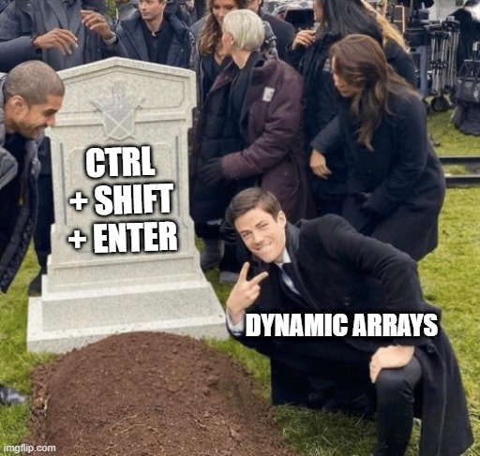

One formula, many cells
Function | What it does
UNIQUE() | Finds the unique items in an array
FILTER() | Filters an array
SORTBY() | Sorts an array
But wait, there’s more: https://support.microsoft.com/en-us/office/dynamic-array-formulas-and-spilled-array-behavior-205c6b06-03ba-4151-89a1-87a7eb36e531
Notes:
Don’t worry too much about the building blocks right now – I have this in here to gauge everyone’s interest

Slide 20
Pulling data fast with dynamic arrays
Continue computers.xlsx
Sort, filter and de-duplicate right from the spreadsheet
Notes:
Now you are hyped up Power Query, I think you are going to love it and it will be hard for you to remember the days when you didn’t have it. So let’s think about what we would do without Power Query.

Slide 21

Exercises
File: penguins.xlsx
Add an index column to this dataset and load it back to an Excel table. You are welcome to profile it too if you wish!
Filter out any missing values.
Create overlapping histograms to visualize the distribution of body mass by species.
How many unique species are in this dataset? What are they?
Pull only the records from the Biscoe island.
Pull only the records that are from Biscoe island and that have a body mass greater than average for that group.
Sort the data by body mass ascending, species ascending, sex descending.

Slide 22
QUESTIONS?

Slide 23
FOUNDATIONS OF EXPLORATORY DATA ANALYSIS
Notes:
Let’s begin with Exploratory Data Analysis in Excel.
Pulse check – who has heard of this term before and how would you define it? Or outside of defining it, what are some examples of it?

Slide 24

What the hey is EDA?
Preliminary understanding of variables
Classify them
Summarize them
Visualize them
Check assumptions before using them
YOU
YOUR DATA
Notes:
What do we mean by EDA? This is the first step of getting to know the data. We just want to see what we are working with and what kind of statistical analysis might be possible from the data.

Slide 25
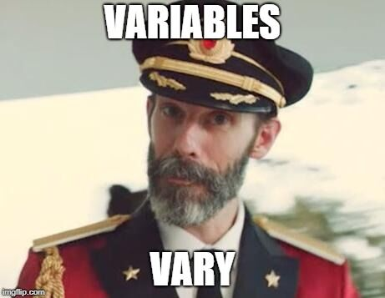
What is a variable?
Classical statistics: at least a 90%/10% split
Notes:
But before we even get into analyzing variables, let’s consider what they even are. It seems like a silly distinction but analyzing variables is what we do as analysts. For classical statistics, a variable needs to have at least a 90%/10% split to be considered a useful variable. This may seem like a trivial point, but consider something like anomaly detection where the event we are interested in may only be a one in a thousand event. This would not be a 90%/10% split, so a lot of classical statistics would have a hard time working on this problem. This is where ML/AI might come in.

Slide 26

VARIABLE TYPES AS RECIPE INGREDIENTS
Notes:
When we get a dataset, we want to see the kinds of variables we have. Think of each variable as like an ingredient. And based on those ingredients we can make different dishes. Like a “Chopped” competition.

Slide 27
WHAT’S ON THE TABLE?
Variable
Categorical
Binary
Nominal
Quantitative
Discrete
Ordinal
Continuous
Notes:
Basic overview of the types of variables:
Broad split b/w categorical and quantitative
First, categorical. For these, there are a fixed number of values that variable can take:
- In the case of binary, it’s two (yes/no, black/white)
- Nominal can have more than two, think of all 50 states, or 7 days of the week
- For ordinal, order matters, consider Freshman/Sophomore/Junior/Senior. However this corresponds to years 1, 2, 3, 4, so these can be numbers too!
Then, quantitative. These are numeric
- With a difference that with discrete, there are only a certain number of values that can be taken, for example, you can’t have 2.5 children, but we often use that as a statistical convenience, so you will see there is some wiggle room here.
- Finally, continuous – this is the one for which there can be any possible value. Height/weight/blood pressure. A lot of things in the natural world. Also money is for all intents & purposes continuous.

Slide 28
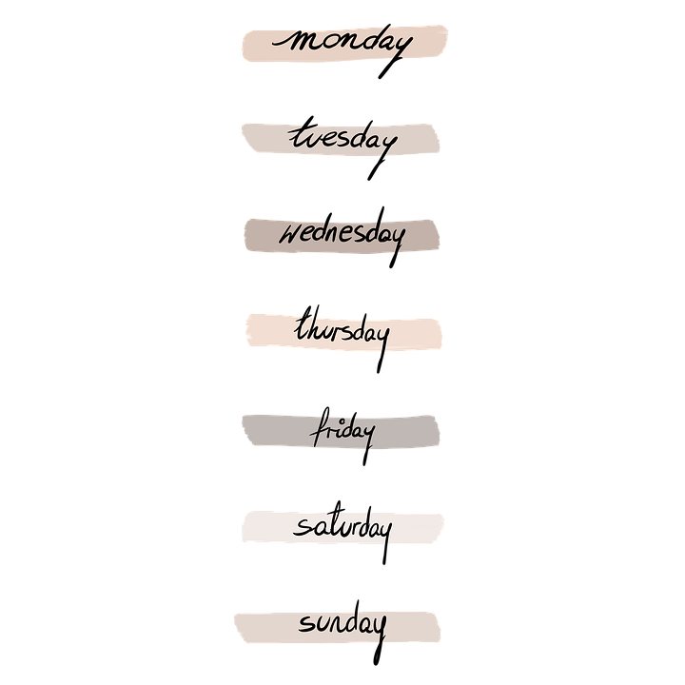


“WHICH KIND?”
Categorical
Binary
Nominal
Ordinal
Notes:
Basic overview of the types of variables:
Broad split b/w categorical and quantitative
First, categorical. For these, there are a fixed number of values that variable can take:
- In the case of binary, it’s two (yes/no, black/white)
- Nominal can have more than two, think of all 50 states, or 7 days of the week
- For ordinal, order matters, consider Freshman/Sophomore/Junior/Senior. However this corresponds to years 1, 2, 3, 4, so these can be numbers too!
Then, quantitative. These are numeric
- With a difference that with discrete, there are only a certain number of values that can be taken, for example, you can’t have 2.5 children, but we often use that as a statistical convenience, so you will see there is some wiggle room here.
- Finally, continuous – this is the one for which there can be any possible value. Height/weight/blood pressure. A lot of things in the natural world. Also money is for all intents & purposes continuous.

Slide 29


“HOW MUCH/HOW MANY?”
Quantitative
Discrete
Continuous
Notes:
Basic overview of the types of variables:
Broad split b/w categorical and quantitative
First, categorical. For these, there are a fixed number of values that variable can take:
- In the case of binary, it’s two (yes/no, black/white)
- Nominal can have more than two, think of all 50 states, or 7 days of the week
- For ordinal, order matters, consider Freshman/Sophomore/Junior/Senior. However this corresponds to years 1, 2, 3, 4, so these can be numbers too!
Then, quantitative. These are numeric
- With a difference that with discrete, there are only a certain number of values that can be taken, for example, you can’t have 2.5 children, but we often use that as a statistical convenience, so you will see there is some wiggle room here.
- Finally, continuous – this is the one for which there can be any possible value. Height/weight/blood pressure. A lot of things in the natural world. Also money is for all intents & purposes continuous.

Slide 30
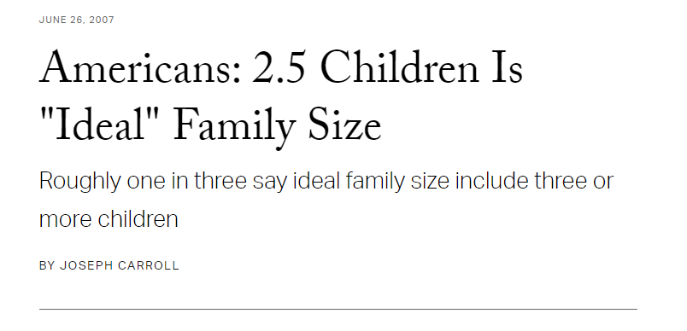
DON’T HOLD ME TO IT…
Treat discrete as continuous (maybe) when:
Large number of observations
Large number of values an observation can take
https://news.gallup.com/poll/27973/americans-25-children-ideal-family-size.aspx
Notes:
Basic overview of the types of variables:
Broad split b/w categorical and quantitative
First, categorical. For these, there are a fixed number of values that variable can take:
- In the case of binary, it’s two (yes/no, black/white)
- Nominal can have more than two, think of all 50 states, or 7 days of the week
- For ordinal, order matters, consider Freshman/Sophomore/Junior/Senior. However this corresponds to years 1, 2, 3, 4, so these can be numbers too!
Then, quantitative. These are numeric
- With a difference that with discrete, there are only a certain number of values that can be taken, for example, you can’t have 2.5 children, but we often use that as a statistical convenience, so you will see there is some wiggle room here.
- Finally, continuous – this is the one for which there can be any possible value. Height/weight/blood pressure. A lot of things in the natural world. Also money is for all intents & purposes continuous.

Slide 31
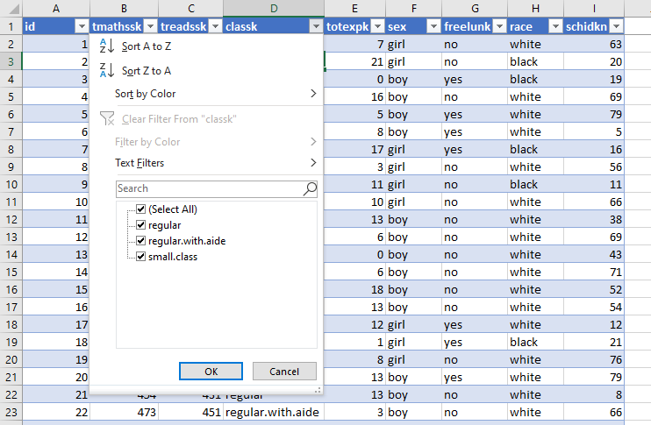
DRILL
File: star.xlsx
What type is each variable?
(Don’t be afraid to poke at the data!)
Variable | Description | Type?
tmathssk | Total math scaled score
treadssk | Total reading scaled score
classk | Type of class
totexpk | Years of total teaching experience
sex | Sex
freelunk | Qualified for free lunch?
race | Race
schidkn | School indicator
Notes:
Check out this dataset of school test scores. Consider what kind of variable you would classify as each. Make your best guess.

Slide 32
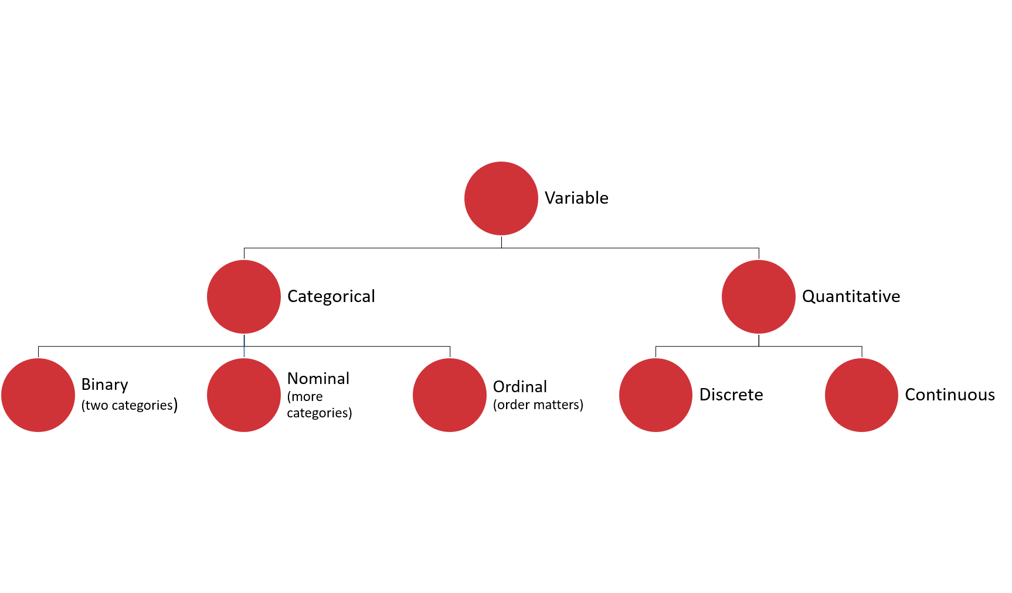
DRILL
File: star.xlsx
What type is each variable?
(Don’t be afraid to poke at the data!)
(Filtering for now…)
Variable | Description | Type?
tmathssk | Total math scaled score | Continuous
treadssk | Total reading scaled score | Continuous
classk | Type of class | Nominal
totexpk | Years of total teaching experience | Discrete
sex | Sex | Binary
freelunk | Qualified for free lunch? | Binary
race | Race | Nominal
schidkn | School indicator | Nominal
Notes:
Here is what I came up with. The first couple are more apparent, but what about things like Years of teaching experience?
That could be an ordinal variable or a discrete variable. It was also difficult to know whether race is binary or nominal, I did it for certain by placing a filter on it to see the distinct values.
Did anyone come up with other classifications and if so would you like to share them?

Slide 33

WHO KNOWS?
VARIABLE TYPES ARE CONTEXTUAL
IT’S NEBULOSE…
https://www.theanalysisfactor.com/level-of-measurement-not-obvious/
Notes:
Sometimes like in the case of the math and reading scores your variable may technically be more like a discrete variable but you can treat it more like a continuous variable. This is a fairly common occurrence. Age is a good example where it is technically continuous but for different reasons we may measure it as multinomial or discrete. I won’t spend too much time on this but if you want to learn more check out this article here which actually talks a lot about how to handle age as a variable.
Great, now we have some idea of the ingredients we are working with, although some of these ingredients are shape-shifters, but we can handle them. What do we do next?

Slide 34
Summarizing a variable: frequencies
Used for categorical variables
How many of each value do we have? (Counts)
Use PivotTables
Notes:
It’s great to look at each observation/row in isolation, but to get the “big picture” of a dataset we are going to have to summarize it.
The way we summarize a variable depends on the kind of variable it is (or at least we think it is!) If it is categorical, we can count it up.
For the demo: create a two-way cross-tab summarizing frequency counts of union/married. [Show/remind that instructions on the demo are available in the demo notes.]

Slide 35
DRILL
Demo: wages.xlsx
(Don’t forget about the demo notes)
Notes:
Let’s take an example here, and don’t forget about the demo notes!

Slide 36
Summarizing a variable: descriptive statistics
Used for continuous variables
Central tendency: what value is the variable centered around?
Mean: “average”
Median: “middle”
Mode: “most common”
Notes:
If our variable is continuous, there are quite a few ways to summarize it. We’ll start with central tendency or, what value is the variable centered around? We have a few options for measuring central tendency: mean, median and mode.

Slide 37
DRILL
You are consulting for a non-profit on fundraising strategies
Donation data is shown to the right
Which measure of central tendency (mean/median/mode) should be tracked?
Variable
10
10
20
30
100
Notes:
There is no right answer here! Just calculate the three statistics, use Excel or an online calculator if you aren’t sure what equations to use.
But again our goal is business impact here so we want to tie these measures to real business use cases.
Leave your thoughts in the chat as to what the important variable is.

Slide 38
DRILL
You are consulting for a non-profit on fundraising strategies
Donation data is shown to the right
Which measure of central tendency (mean/median/mode) should be tracked?
No one statistic rules them all
Variable
$10
$10
$20
$30
$100
Statistic | Value
Mean | $34
Median | $20
Mode | $10
Notes:
It depends what you want to track!
The average donation is perhaps inflated by the $100, and that is a big downside of using the average.
That is why the median can be more revealing as it is more reflective of a true “middle ground” which is also important to know.
Finally, you might want to know what the most common donation is, that would be the mode.
So, they are all important!
But, usually we are going to analyze the mean because that is more receptive to advanced analysis, you’ll see that if data is normally distributed, then the mean will be the most revealing measure for us.
You will also see from this example the importance of having enough data! Kinda hard to know what’s going to be important with only five observations!

Slide 39
Summarizing a variable: descriptive statistics
Variability: how spread is the variable from the center?
Range: What are the min/max?
Variance: Relative to the mean, how far away does the data fall?
Standard deviation: Square root of the variance
Notes:
Now that we have established where the “center” of the variable is, we can explore how “spread” the variable’s values are from the center.
The most basic measure for this is the range or the min/max.
Then there is the variance and the standard deviation – these are more sophisticated measures of how far a value falls on average, relative to the mean.
Standard error – how much variation can we expect in our means if we drew many random samples.

Slide 40
HAVE YOU INSTALLED THE DATA ANALYSIS TOOLPAK?
Notes:
Has everyone done this? If not, check the demo notes and/or follow along with the next two slides.
The steps are different for Mac versus Excel.

Slide 41
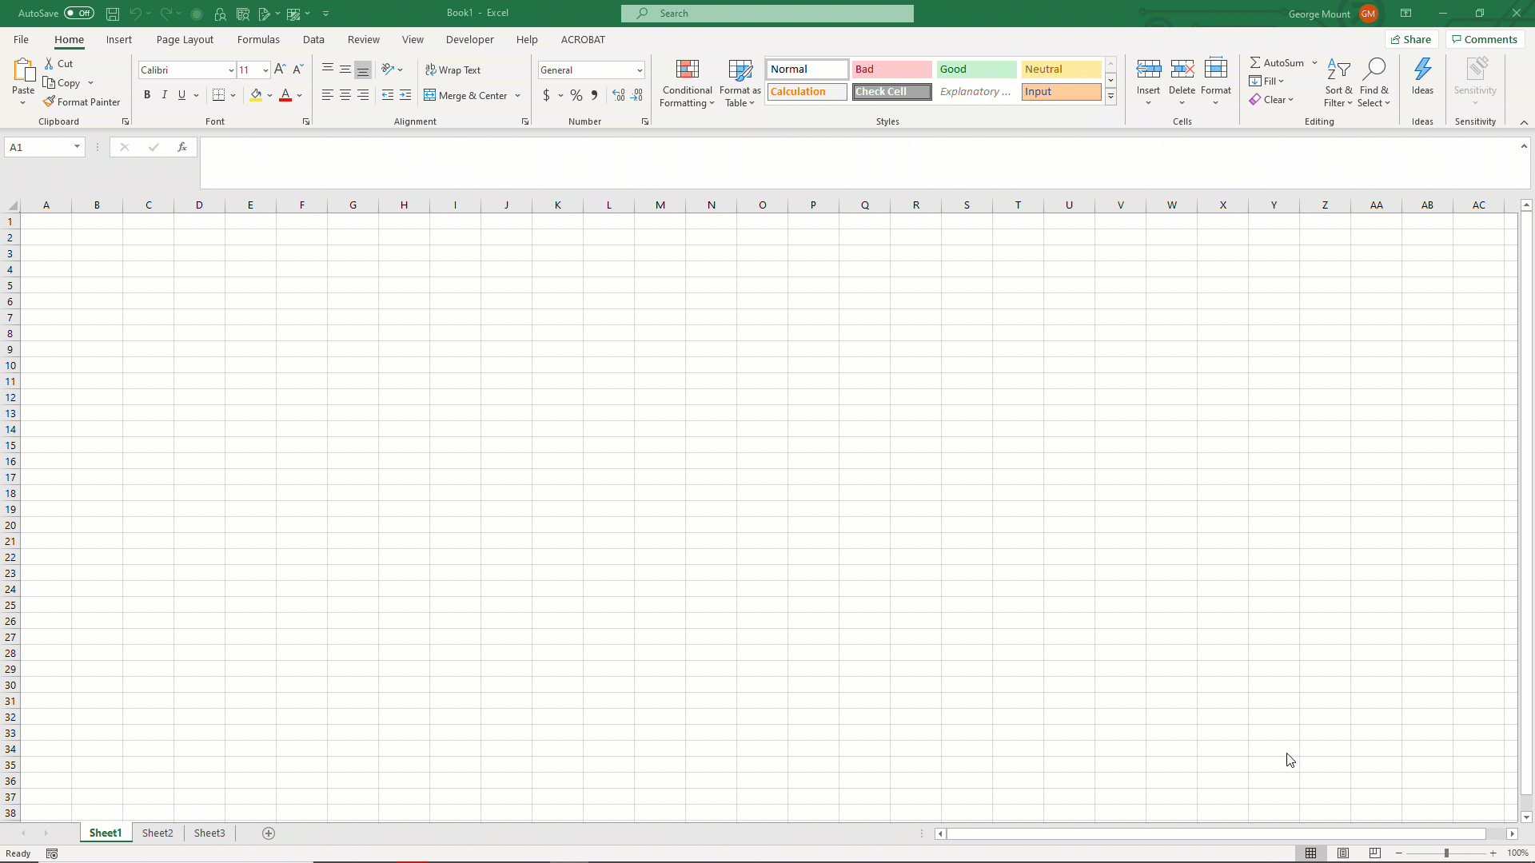
ON WINDOWS:
File → Options → Add-ins
Click Go toward the bottom of the menu
Select Analysis ToolPak from the menu
Click OK
It is not necessary to select the Analysis ToolPak–VBA option

Slide 42
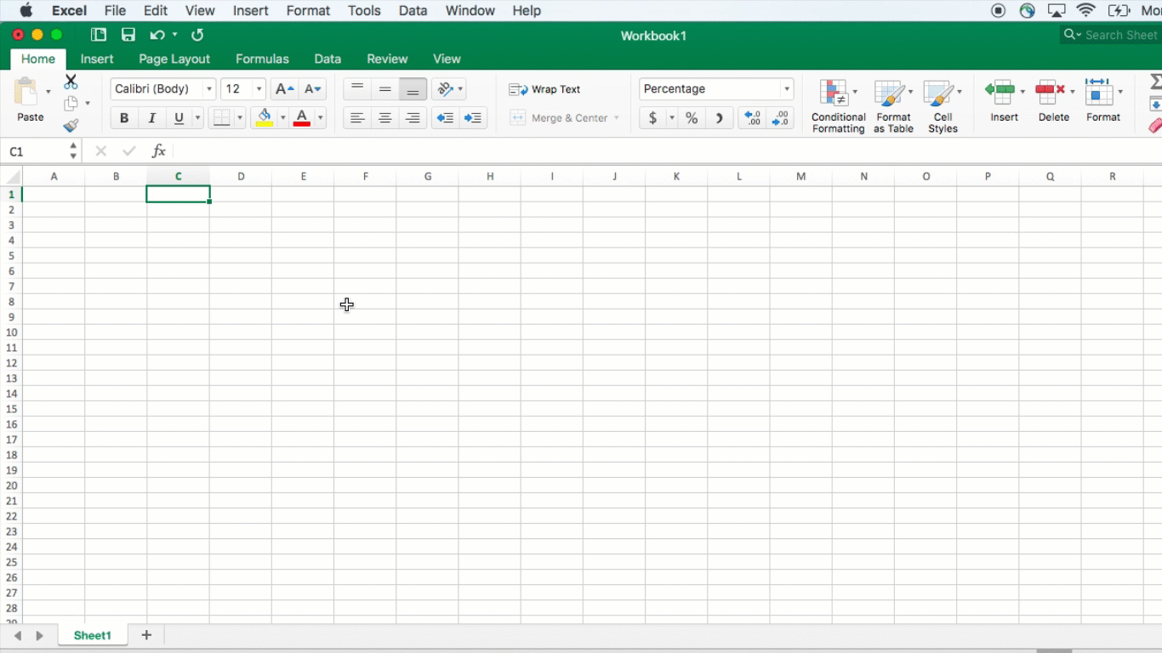
ON MAC:
Data → Analysis Tools
Select Analysis ToolPak from the menu
Click OK
It is not necessary to select the Analysis ToolPak–VBA option

Slide 43
DEMO
File: wages.xlsx
Summarize wage with the Analysis ToolPak
Notes:
Give me a thumbs up when everyone has this installed.
Open up the wages dataset, we will now summarize a continuous variable (wage) using the Analysis ToolPak.
Another reminder to use the demo notes.

Slide 44
Summarizing a variable: visualization
Histogram
What does the data’s distribution “look like?”
How many data points lie with each bin?
Notes:
Getting the measures of skewness/kurtosis is great but there’s nothing quite like a picture! Let’s draw the actual visualization with a histogram.

Slide 45
DEMO
File: wages.xlsx
Visualize wage with a histogram
Notes:
Let’s do it!

Slide 46
DRILL
File: housing-descriptive.xlsx
Explore this dataset:
Choose a categorical variable and run its frequencies
Choose a continuous variable, run its descriptives and plot a histogram
Notes:
Now it’s your turn to do each of the three steps.
This is a real life dataset on housing prices. Do some EDA on this data.

Slide 47
QUESTIONS?
Notes:
Any questions on descriptive statistics?

Slide 48
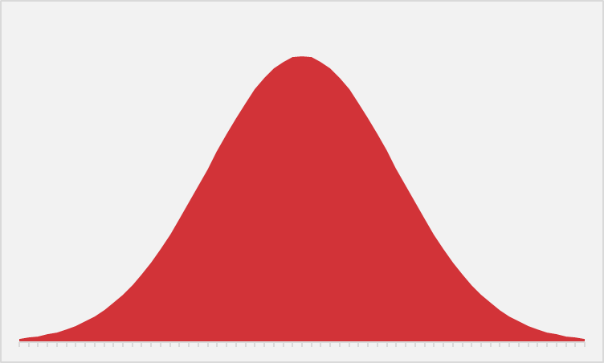
EVER WANTED TO JUST BE NORMAL?
STATISTICS IS YOUR CHANCE.
Notes:
The normal distribution of paramount in statistics. We are able to extrapolate pretty well about a variable’s value when it falls on a bell curve because we know exactly how “spread” the variable’s values are around its center.
Next slide for some specifics.

Slide 49
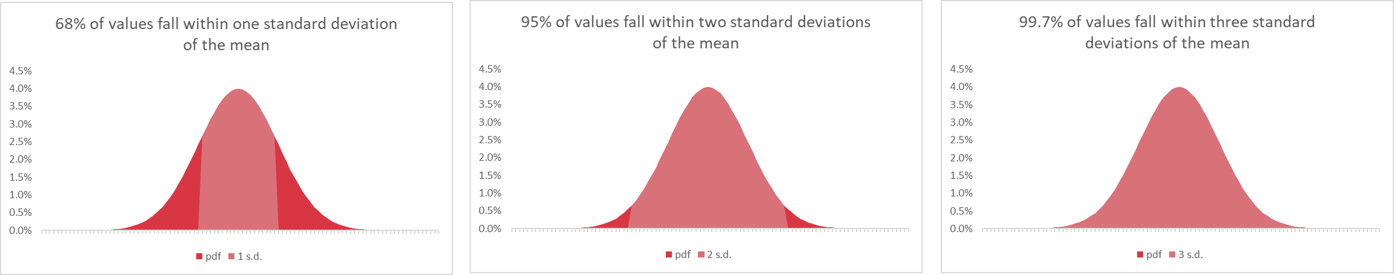
WHAT DOES IT MEAN TO BE NORMAL?
“Empirical rule”
https://www.katemarshallmaths.com/chapter-3-bell-shaped-distribution.html
Notes:
This is called the empirical rule and it tells us how many observations we expect to fall within how many standard deviations of the mean. We can expect that 68% of our observations fall within 1 standard deviation, 95% within 2, and 99.7% within 3. This allows us to state how likely or unlikely it is to get any certain value.

Slide 50

SPOTTING NORMAL DISTRIBUTIONS
There are no “perfectly” normally distributed variables, but some are more normal than others:
Descriptives: skewness ± 8, kurtosis ± 20
Visualizations: does it “look” normal?
Inferentially: is it statistically distributed differently than normal?
https://www.katemarshallmaths.com/chapter-3-bell-shaped-distribution.html
Notes:
https://pixabay.com/photos/bigfoot-evolution-anthropoid-ape-542546/
The interesting thing about the normal distribution is that while we see approximations to it everywhere, it’s nearly impossible to find it perfectly in real life. Some ways we can check whether a variable is normally distributed enough are with descriptive statistics. We can check whether its skewness and kurtosis fall within a certain range, this is a pretty generous range here, but a perfectly normal distribution will have a skewness and kurtosis of 0, so the closer to 0 the more normal it is.
We can also visualize it and we’ve been using histograms to do that. With this we can see whether the variable “looks” normal, or how “bell-shaped” it appears.
Finally there are some other ways to test normality but we won’t get into those, we can perform a statistical test to check whether our variable is likely to be different than normal. The cool thing is that after this course you will understand how tests like these work at a basic level.

Slide 51
Python for Excel

Slide 52
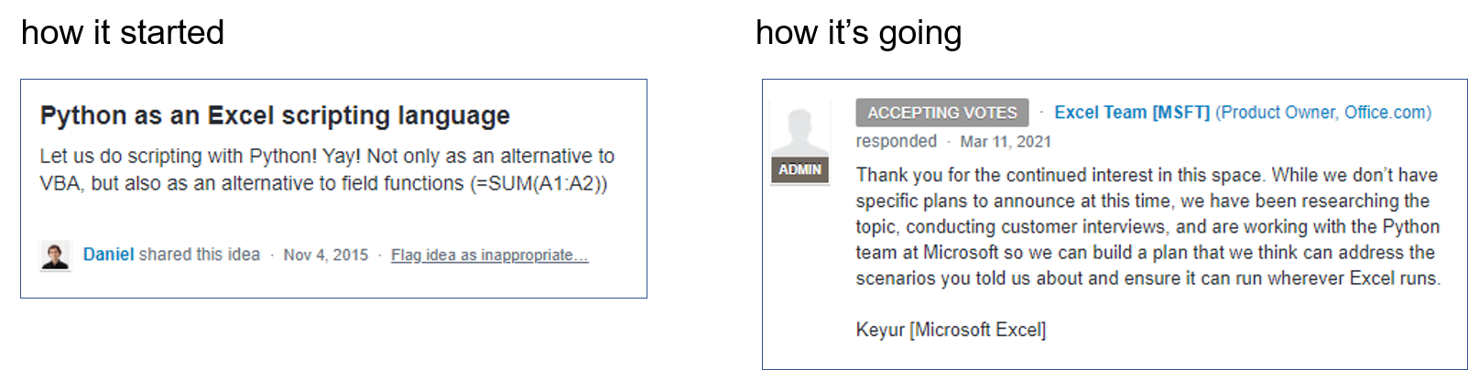

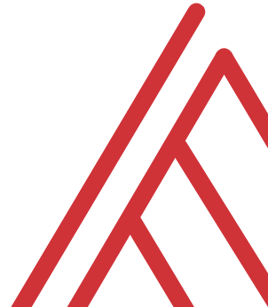
It’s coming, probably…

Slide 53

Why Python in Excel?
Versatility
Package management
Engineering

Slide 54
Demos
Python-Powered Excel with pandas
Good for getting data in and out, analyzing data
But what is missing?
File: pandas-excel.ipynb
Notes:
OK so now you will see R’s equivalent to some of those features you saw with Python. I think that for different reasons Python seems to be taking the lead on Excel automation, but R has some pretty robust features and in some ways are richer than Python’s.

Slide 55
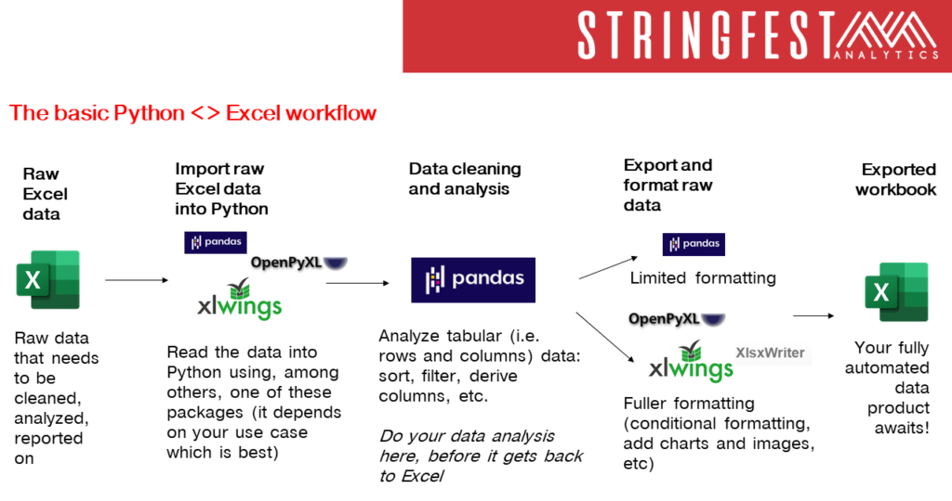

Slide 56
Demos
Python-Powered Excel with xlxswriter
Full-on automation
But what is missing? (It’s in the name)
File: xlsxwriter-excel.ipynb
Notes:
OK so now you will see R’s equivalent to some of those features you saw with Python. I think that for different reasons Python seems to be taking the lead on Excel automation, but R has some pretty robust features and in some ways are richer than Python’s.

Slide 57
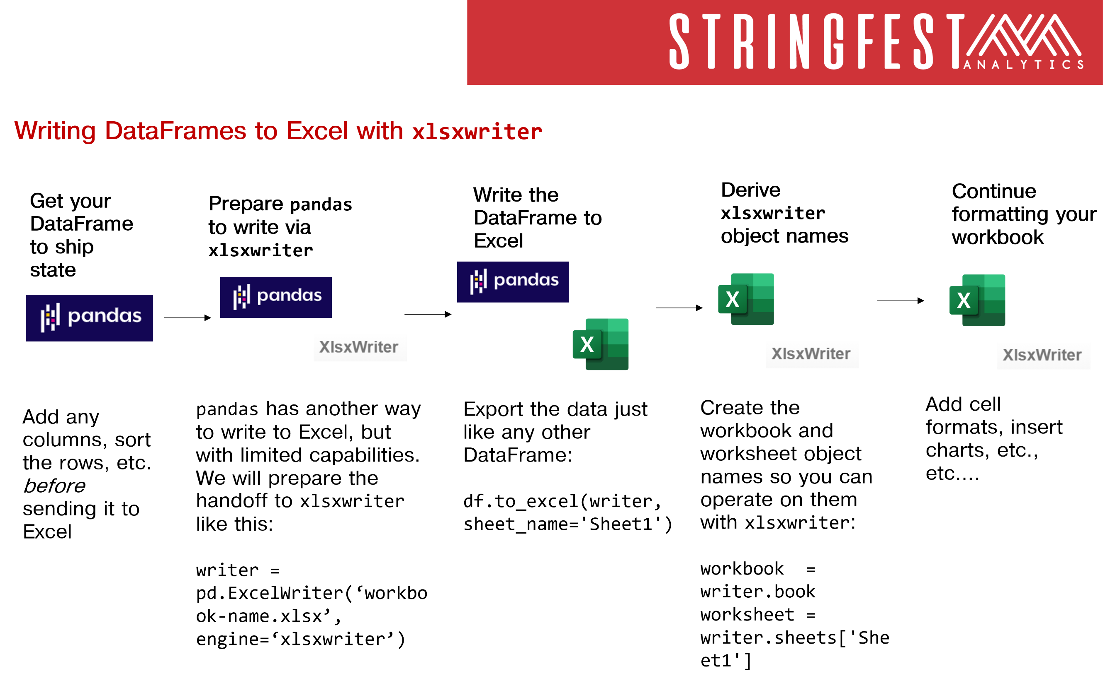

Slide 58
QUESTIONS?
SEE YOU FOR DAY 2!
Notes:
Any questions on descriptive statistics?

Slide 59
Day 2… tentatively, at least

Slide 60
Python functions for Excel with xlwings

Slide 61
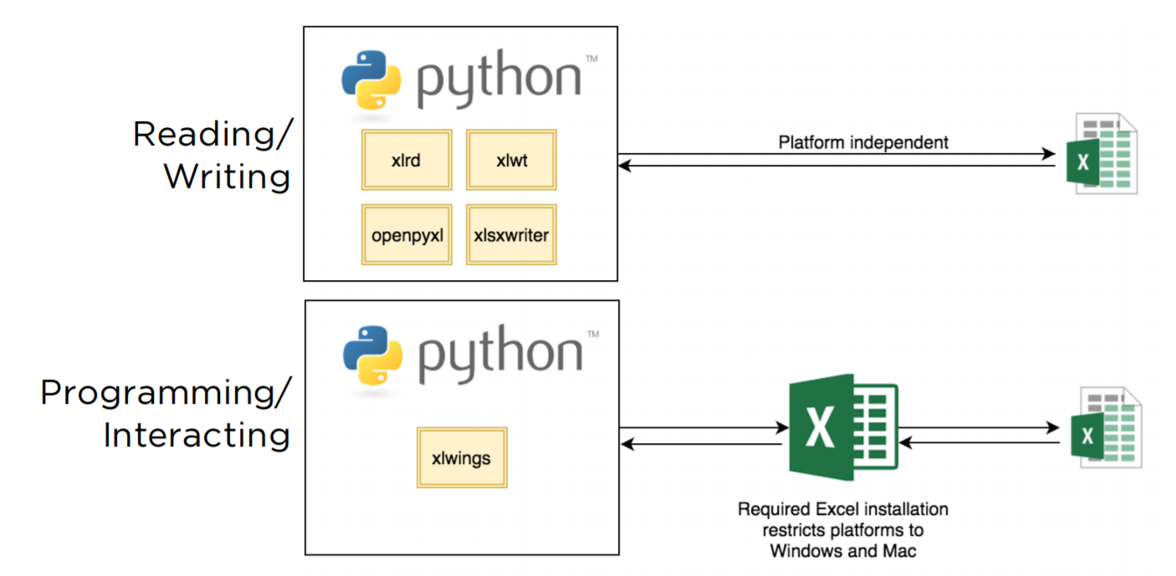
Xl is given wings
Automate Excel reports
Call Python from Excel
Expose workbook as API
Write user-defined functions

Slide 62
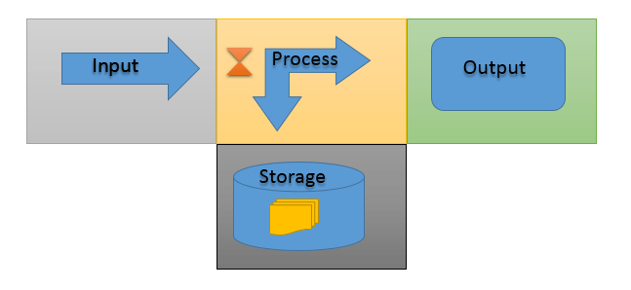
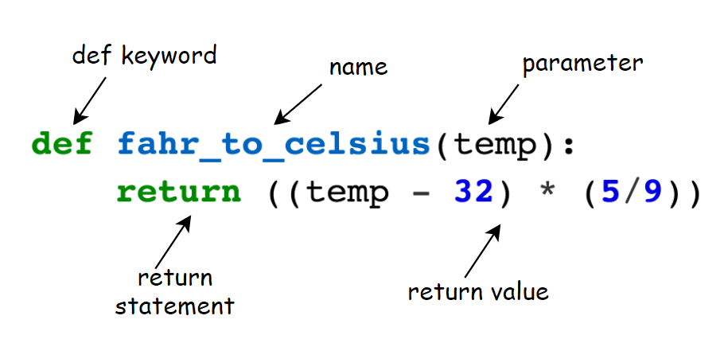
You know functions
https://www.computernetworkingnotes.com/networking-tutorials/basic-functions-of-a-computer-explained.html
https://bham-carpentries.github.io/2018-12-17-bham_python-novice-inflammation/09-func/index.html

Slide 63
Demo
Python functions in Excel – your new macro workbook
From a blank workbook:
Set up xlwings add-in
Define and test Python functions in Excel
Notes:
OK so what we are going to do here is go back to your session or open a new one. Go to the diamonds.r dataset. And let’s actually conduct the analysis that was hinted at earlier.

Slide 64
FOUNDATIONS OF DATA SCIENCE
Notes:
Let’s begin with Exploratory Data Analysis in Excel.
Pulse check – who has heard of this term before and how would you define it? Or outside of defining it, what are some examples of it?

Slide 65

STATROULETTE
A roulette wheel returns values between 0 and 36.
Let’s simulate a game of roulette in Excel
Notes:
Instructions follow on the next slide.

Slide 66
DEMO
Simulate 500 rounds of a roulette spin.
Plot the resulting frequency distribution.
Notes:
More instructions on next slide.
Ask if anyone knows what formula to use for this.

Slide 67
DEMO
Simulate 500 rounds of a roulette spin using RANDBETWEEN(0,36)
Plot the resulting frequency distribution using a histogram
Hit F9 while in your workbook. What happens?
Notes:
Resulting screenshot to be shown on next slide.
If you need help with the plotting, go to the older demo notes, that’s what we did before.
Don’t look ahead in the slides!

Slide 68
DEMO
Now, simulate a roulette spin 100 times.
Take the average spin.
Do this 500 times.
Plot the distribution of sample means
Solution: stat-roulette.xlsx
Notes:
Now we will take the average roulette spin after spinning 100 times. Do this 500 times and plot the histogram of the average spins. What happens this time?
Don’t look ahead in the slides!

Slide 69

MAGIC… OR STATISTICS?
Central limit theorem: the sampling distribution of the mean of any independent, random variable will be normal or nearly normal, if the sample size is large enough.
Notes:
Magic, or statistics? This is courtesy of the central limit theorem. Sample means tend to normality, which means since we know the probability distribution, we can make reliable estimates about a population, given a sample, as we extrapolate to that population.

Slide 70
How “large enough” is large enough?
N = 30? 60? 100?
It depends on how “normal” your sample is
Notes:
The big caveat is that a sample has to be “large enough.” What does that mean? Well, the base case is 30. 60 is better and 100 is even better. If your data’s sample is already looking normal, it’s going to take a smaller sample size to hit that “large enough” qualification. So generally a normally distributed variable is considered a requirement to do these statistics in practice, whereas in theory this is not such a dead-locked requirement.

Slide 71

MEET ME IN THE MIDDLE
A roulette wheel returns values between 0 and 36.
What is the average roulette spin given more and more spins?
Notes:
https://unsplash.com/photos/3qMOyoqI-JM
Instructions follow on the next slide.

Slide 72
DEMO
large-numbers.xlsx

Slide 73
MAGIC… OR STATISTICS?
Law of large numbers: the average of results obtained from trials become closer to the expected value as more trials are performed
Notes:
Magic, or statistics?

Slide 74
QUESTIONS?
Notes:
Ok, let’s end our EDA module on the Central Limit Theorem as you’ll see it’s the “missing link” between descriptive and inferential statistics.
We are done with the first module! Any questions?

Slide 75

HOUSES WITH AIR CONDITIONING ARE BETTER THAN THOSE WITHOUT
Notes:
Again, I really want to focus this on real-life business applications so this is not some academic undertaking, so let’s say that we are real estate analysts and we want to consider what kinds of features on a house help.
We might start with a claim like this. I don’t think anyone would disagree with this statement, but how would we actually quantify that? What can we measure to compare a difference in quality between houses with and w/o air conditioning?

Slide 76
HOUSES WITH AIR CONDITIONING ARE BETTER HAVE HIGHER SALES VALUES THAN THOSE WITHOUT
Notes:
Price! Price is a readily quantifiable value that could stand in for quality that I think a lot of business managers would be pleased with learning more about. Do homes with AC sell for a higher value? Now we are talking business.

Slide 77
HOUSES WITH AIR CONDITIONING ARE BETTER HAVE HIGHER SALES VALUES THAN THOSE WITHOUT, ON AVERAGE
Notes:
But let’s qualify further, how are we going to compare housing prices? Well, we could ask on average whether homes with AC sell for higher. Now we are making a readily measurable claim.

Slide 78
HOUSES WITH AIR CONDITIONING HAVE HIGHER SALES VALUES THAN THOSE WITHOUT, ON AVERAGE, GIVEN THE SAMPLES WE HAVE
Notes:
Of course, we can’t measure the sale price of EVERY house, we are going to take a sample. So we need to be very specific about what we are measuring.
However you are going to find that through some of the principles you learned earlier that we can actually make some claims about ALL houses given a SAMPLE of houses that we took.

Slide 79

THE AVERAGE VALUE OF ONE CATEGORY IS HIGHER THAN ANOTHER
(Independent samples t-test)
Notes:
Let’s think about what we just did here, essentially we are looking for a difference in the average of some continuous variable between two categories. Going back to our analogy, with these two ingredients we can make the “recipe” of an independent samples t-test.
Before we run the test, we want to fully explore the variables we are going to test. This is like measuring out our ingredients to make sure the recipe is right.

Slide 80

DEMO
File: housing-foundations.xlsx
Is there a difference in sales price for homes with air conditioning (airco)?
Find the descriptive statistics and plot the histograms for each category
Notes:
So, using the tools we’ve learned so far (frequencies, descriptive statistics, histograms), let’s see what we can learn about a difference in means between homes w/ and w/o AC.

Slide 81

DRILL
File: housing-foundations.xlsx
Is there a difference in sales price for homes with a full, finished basement (fullbase)?
Save your work – you’ll “build on” it later!
Notes:
Photo source: https://unsplash.com/photos/T-br3SYp9kw
Now it’s your turn to follow the steps taken so far.
“Build on” is a pun :P

Slide 82
EXPLICIT WARNING:
MATH AHEAD
Notes:
Brace yourselves!

Slide 83
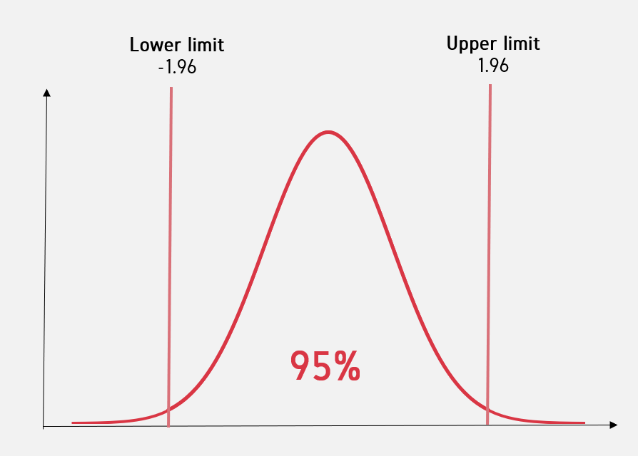
Does the test score exceed the critical value?
Yes: Reject the null. There is likely to be a significant difference in means.
No: Fail to reject the null. There is unlikely to be a significant difference in means.
Two-tail t-test
Notes:
If a test statistic exceeds the critical value, then we would reject the null.
Otherwise, we fail to reject the null.
Notice the delicate language here?

Slide 84
QUESTIONS?
Notes:
Any questions about the “hypothetical” stuff here so far? (lol)
Don’t get too hung up on this part, it will make more sense in action when we actually begin to crunch the numbers in Excel.

Slide 85
DEMO
File: housing-inferential.xlsx
Is there a significant difference in sales price for homes with air conditioning?
Notes:
So, we analyzed the sample data, now let’s check for a “generalizable” difference based on these samples. This is “statistical significance.” Follow along and check the Demo Notes later.

Slide 86
DRILL
File: housing-inferential.xlsx
Is there a significant difference in sales price for homes with a full, finished basement?
Save your results for later!
Notes:
Your turn to walk through a t-test.

Slide 87
DEMO -- SUMMARY
Two-tailed independent samples t-test
95% confidence = critical value of 1.96 = p-value of .05
p < .025
p < .025
Notes:
So, we analyzed the sample data, now let’s check for a “generalizable” difference based on these samples. This is “statistical significance.” Follow along and check the Demo Notes later.

Slide 88
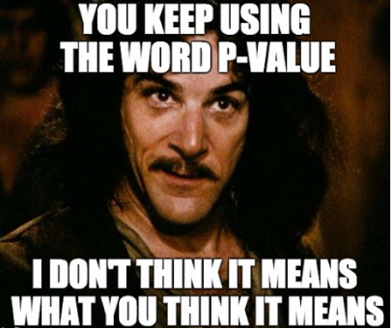
A p-value is NOT a probability of making a mistake.
A p-value is the probability of obtaining an effect at least as extreme as the one in your sample data, assuming the null hypothesis is true.
Notes:
So, we calculated the p-value and found significance, but what did we actually find here? It is NOT the probability of making a mistake, it is a measure of how likely it would be to find the observed difference in means, if there were actually no difference in population means.
Let’s walk through some p-value interpretations on the next slide.

Slide 89
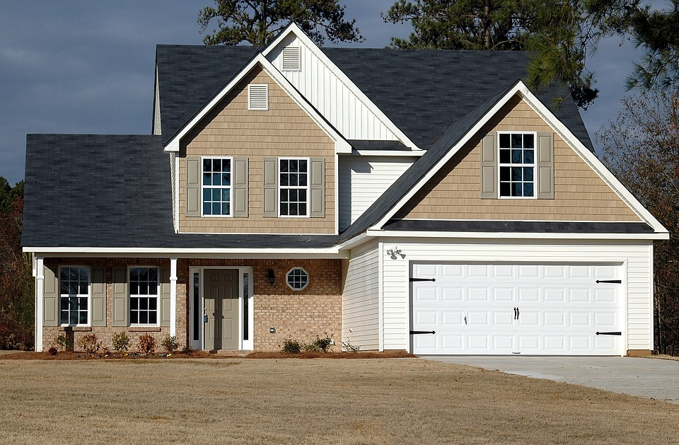

SOLD: $200,000
SOLD: $200,000
If this were true in the population, you’d have found this in < .005% of samples due to random error.
Notes:
Your turn to walk through a t-test.

Slide 90
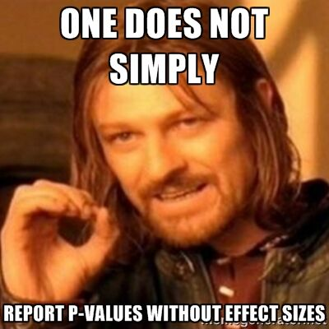
A p-value is NOT a substantive measure.
A p-value does not tell you how much of a difference there is, only that there is likely to be a difference.
The confidence interval will give us a substantive measure.
Notes:
A p-value also doesn’t tell us how BIG the difference/effect is. It would stand to reason that the lower the p-value, the bigger the actual difference in means, but this isn’t necessarily true. If we want to know the actual bounds within which we are assuming the population means to fall, we would want to calculate the confidence interval.
It’s a good idea to calculate the confidence interval! Unfortunately many statistical programs such as Excel and Python do not give you the confidence interval by default. (R does!) so we will have to take it into our own hands. Don’t become overly dependent on the p-value!

Slide 91
DEMO
File: housing-ci.xlsx
Calculate the confidence interval for difference in prices for homes with air conditioning
Notes:
We will continue in our analysis of air conditioning & prices, again the confidence interval is not included with the ToolPak so we will have to crunch these numbers ourselves.

Slide 92
DRILL
File: housing-ci.xlsx
Calculate the confidence interval for difference in prices for homes with a full, finished basement
Notes:
Now it’s your turn to build on your analysis from the last drill.

Slide 93

PRESENTING STATISTICAL RESULTS FOR BUSINESS IMPACT
Methods are not stories
Translate to the universal denominator … $
“The results were significant at p < .005” or
“With 95% confidence, a house with AC sells for between $6K and $15K more.”
Notes:
That’s great but what about actually taking this analysis to your boss? I don’t think a lot of bosses would want to hear about what your test statistic was and what critical value you used. You instead want to tell some cohesive story about the data analysis.
Now this is not a class about storytelling with data, and there are some OLT classes that would help with this, but I know one thing that always tells a good story to managers is MONEY. Money talks, right? So the most you can bring your analysis into actual money, the better.
Finally, when in doubt with how to drive home a data story, it’s never a bad idea to visualize your results, so let’s do so with a t-test.

Slide 94
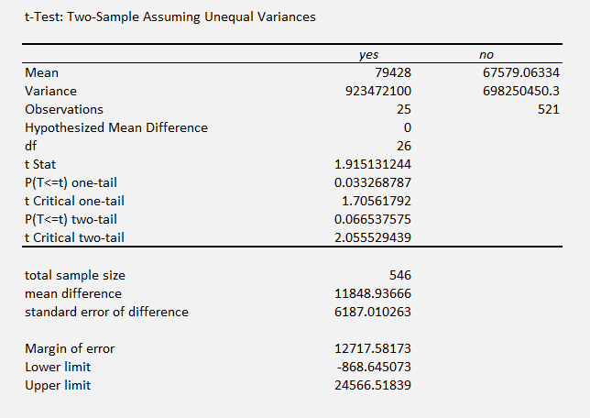
It’s your world, the data is just living in it
A p-value has wiggle room
A confidence interval communicates what’s at stake
A larger sample size can lead to more robust results
CASE
WHEN condition THEN result-expression
WHEN condition THEN result-expression ...
ELSE result-expression
END AS alias
Notes:
Here is an interesting analysis. There doesn’t appear to be a difference in prices of homes with gas heating, but our sample size of Yes’s is only 26! And guess what, we are looking at a swing of between -$900 and $24,500. So I wouldn’t reject this out of hand just because it’s a .06 p-value. I would want to get a little more Yes data to make this relationship a little more clear.
So, this analysis is just a guide, it’s not the be-all, end-all!

Slide 95
QUESTIONS?
Notes:
We are done with t-tests, any questions!
On to the conclusion.

Slide 96
The future of analytics & Excel
Notes:
OK, so now that you have a fuller perspective on what analytics is and how to do it in Excel, let’s take a look at the future and how different kinds of analytics might be working with Excel.

Slide 97

Artificial intelligence comes to Excel
Notes:
Now we are used to structured data but unstructured data is coming into vogue and there are ways to use them together…

Slide 98

Artificial intelligence comes to Excel
Ideas
New data types
Insert Data from Picture
Dynamic arrays
https://www.microsoft.com/en-us/microsoft-365/blog/2018/09/24/bringing-ai-to-excel-4-new-features-announced-today-at-ignite/
Notes:
Now we are used to structured data but unstructured data is coming into vogue and there are ways to use them together…

Slide 99
Demo
Analyze Data
File: wholesale-customers.xlsx
Use AI to generate insights
Use Power Query to reshape data for better insights
Querying a dataset with natural language
Notes:
Let’s take an example where we will use Azure to predict the sentiment of a bunch of Yelp reviews and then compare these to the original stars left.
This will be our final demo and then there will be some wrap up and next steps. If you are going to the next course there will be a couple of to-do’s for you as well which we’ll walk through.

Slide 100
Machine learning is cool, but have you tried tidy data?
X
Y
Z
X
Y
Z
1
2
3
Each variable in its own column
Each observation in its own row
Every cell is a populated observation-variable intersection…
Notes:
Now we are used to structured data but unstructured data is coming into vogue and there are ways to use them together…

Slide 101




Data: more than rows and columns
Structured
Unstructured
Notes:
Now we are used to structured data but unstructured data is coming into vogue and there are ways to use them together…

Slide 102
Demo
Excel for unstructured data
Folder: sentiment
Read in a picture of reviews
Analyze the sentiment of each review
Notes:
Let’s take an example where we will use Azure to predict the sentiment of a bunch of Yelp reviews and then compare these to the original stars left.
This will be our final demo and then there will be some wrap up and next steps. If you are going to the next course there will be a couple of to-do’s for you as well which we’ll walk through.

Slide 103
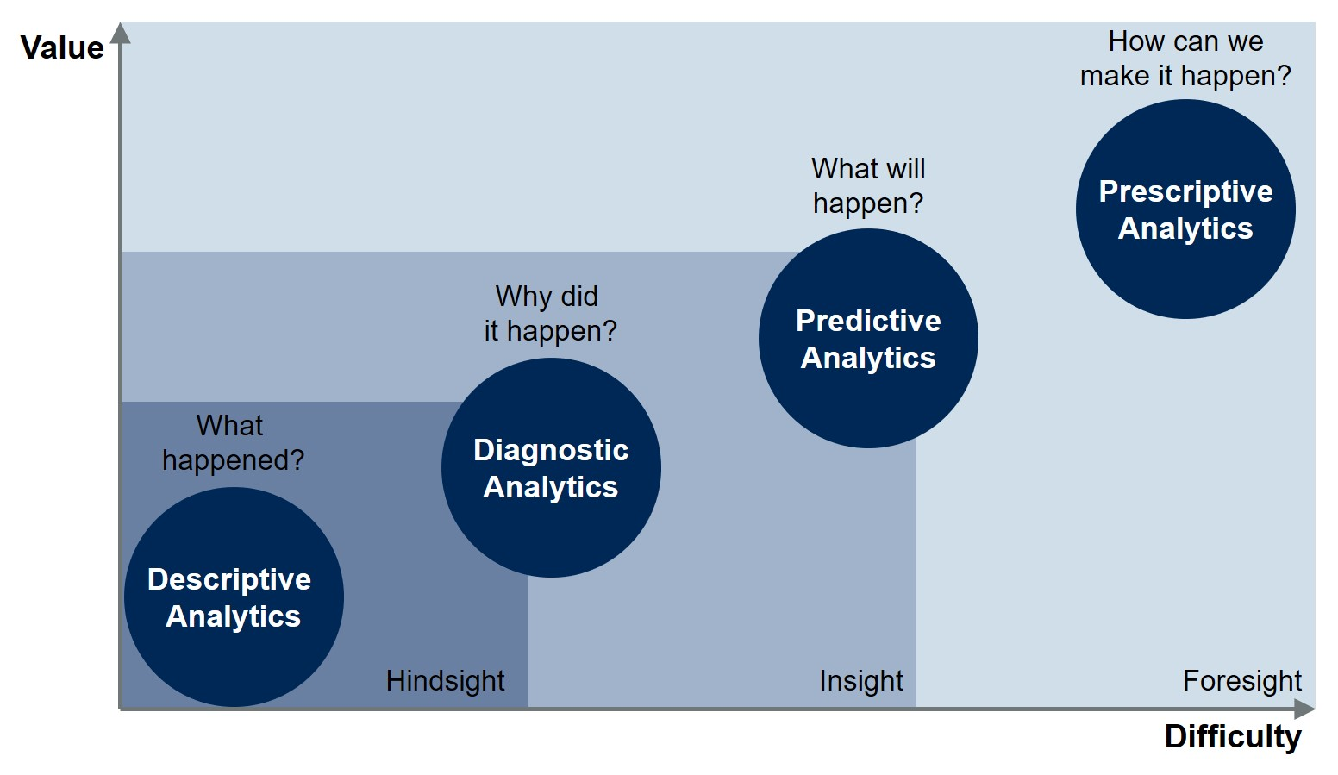
Prescriptive analytics and post-modern Excel?
https://blogs.gartner.com/jason-mcnellis/2019/11/05/youre-likely-investing-lot-marketing-analytics-getting-right-insights/
Notes:
Now we are used to structured data but unstructured data is coming into vogue and there are ways to use them together…

Slide 104
4. CONCLUSION

Slide 105
Advancing into Analytics: From Excel to Python and R
stringfestanalytics.com/book/
Human Centered Design • MDLS 2020
Notes:
This is a more “modern” approach to statistical analysis in Excel and will show you techniques like clustering, naïve Bayes, and things that you might not have thought possible in Excel, but again by learning them in Excel you get a really hands-on look at how these algorithms work that you may not necessarily get in R or Python (I quoted from this book way at the beginning in explaining why we would want to learn this stuff in Excel!)
The final chapter of this book does show you how to move into R from spreadsheets which is not a bad idea when you want to “productionize” what you have learned, but spreadsheets are really an awesome learning tool.

Slide 106

LET'S TALK
LINKEDIN
linkedin.com/in/gjmount
EMAIL ADDRESS
george@stringfestanalytics.com
WEBSITE
stringfestanalytics.com
GITHUB
github.com/summerofgeorge
Notes:
Thanks for coming! Feel free to contact me anytime, find me on LinkedIn, I also write frequently on this stuff so check out my website too.

Slide 107
QUESTIONS?
Notes:
Any final questions?

